Slide 1

INSTAGRAM USERS ANALYTICS

Slide 2

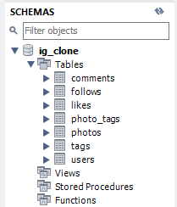
Project Description:
Instagram is a widely used social media platform and can be useful for many things. Like reaching new customers for your product by social media marketing or knowing the recent trend to follow and gain audience engagement.
This project aims to analyze user’s data and get actionable insights for Marketing Analysis and Investor Metrics. E.g.: Finding the most loyal or old users of this platform, the most liked picture posted on Instagram, users who left using Instagram, finding trending hashtags, and much more using MySQL Workbench.

Slide 3

Approach:
First, start with importing the dataset into MySQL workbench 8.0 using the pre-made syntax provided in the dataset file.
After that, explore data using the "SELECT" syntax to get deep information about all the rows and columns including data type and constraints.
Now time to analyze the data using various SQL basics and advanced methods and syntax to get all the requested data from the management. Including uses of Joins, Group By, Order by, Case, Aggregates functions, etc.
Finalizing the report after getting the requested data and showing the insights to the management team for the growth of the company as well as for investors.

Slide 4



Tech-Stack Used:
MS Word 2019 Student Edition
MS PowerPoint 2019 Student Edition
MySQL Workbench 8.0

Slide 5
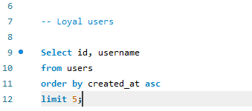
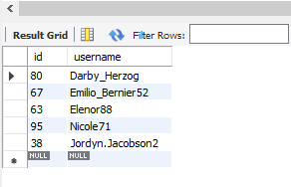
Insights:
A. Marketing Analysis:
Loyal User Reward
Q. Identify the five oldest users on Instagram from the provided database.
By analyzing and extracting data, we got that the below users are the first or the 5 loyal users of Instagram:
Daryby_Herzog
Emilio_Bernier52
Elenor88
Nicole71
Jordyn_Jacobson2
Understanding: After checking the “users” table, we got to know that we have the “created_at” column in it and this helped us to extract the first 5 users who opened accounts and are the loyal users.

Slide 6
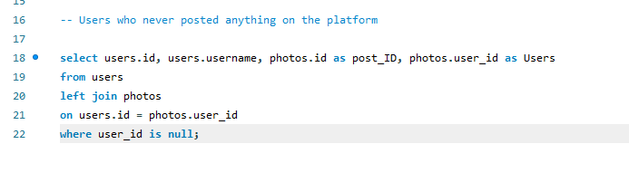
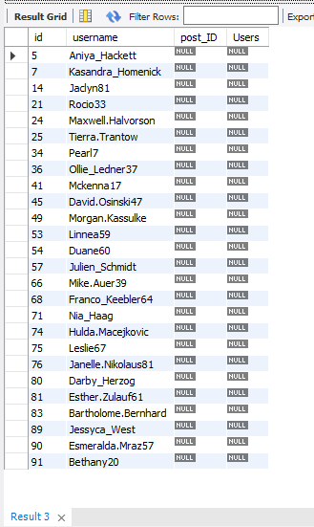
Inactive User Engagement:
Q. Identify users who have never posted a single photo on Instagram.
Understanding: When we were exploring the raw data, we got that we had two tables “users” and “photos” and both had a common row named "id" and "user_id" respectively. We are able to join the table and find the users with null values in the photo table.
After cleaning and extracting the right data, we were able to find that we have 26 accounts that never posted any picture on Instagram and now we can share this information with the marketing team in order to send promotional emails.

Slide 7
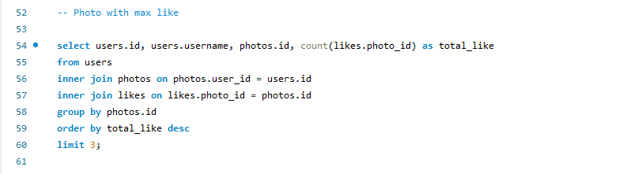
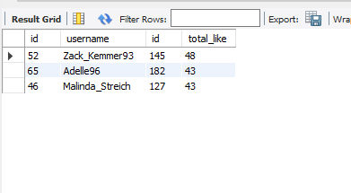
Contest Winner Declaration:
Q. Determine the winner of the contest of most likes on single photo and provide their details to the team.
Understanding: We know that we have a likes table, photos table, and users table with the usernames. So this time we need to join these three tables to get details of the user with max like on a single photo after grouping them according to photo ID.
After joining and grouping the data according to the requirement, we got that photo ID: 145 has the maximum number of likes which is 48 and the username is: Zack_Kemmer93.

Slide 8
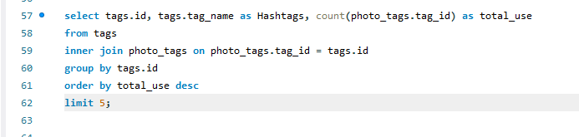
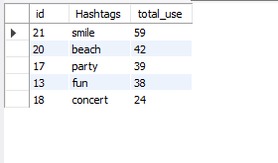
Hashtag Research:
Q. Identify and suggest the top five most commonly used hashtags on the platform.
Understanding: While exploring the data, we got to know that we have two tables named photo_tags and tags with information related to the use of each tag with photo ID and tag name with tag ID. So we just need to join these two tables and count the uses of the tag after grouping the output according to the tag name.
After joining and extracting the required output, we found that Smile, beach, party, fun and concert are the top 5 used hashtags.

Slide 9
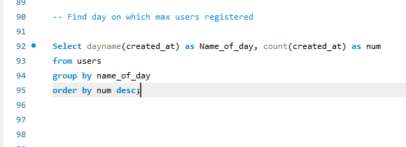
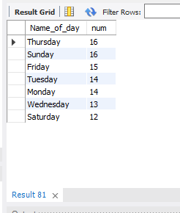
Ad Campaign Launch:
Q. Determine the day of the week when most users register on Instagram. Provide insights on when to schedule an ad campaign.
Understanding: While reading the question carefully, we got that we need to extract the day name using the user's table, and after that group them using the day name will show the required data.
After extracting the day name using the dayname() syntax and grouping them using the name, we got that Thursday and Sunday are the busiest days of the week with 16 registrations on each day.

Slide 10
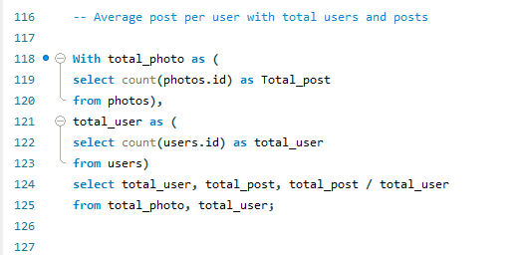
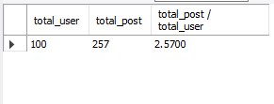
B. Investor Metrics:
User Engagement:
Q. Calculate the average number of posts per user on Instagram. Also, provide the total number of photos on Instagram divided by the total number of users.
Understanding: To find the correct solution to the above question, we need to solve multiple queries at once. For that, we used CTE (Common Table Expressions) which uses "With" syntax and helps us to solve multiple sub query in a single main query.
After using the WITH syntax, we are able to get total_user(100) and total_post(257), and by using these temporarily made columns we got the average post per user which is 2.5700.

Slide 11
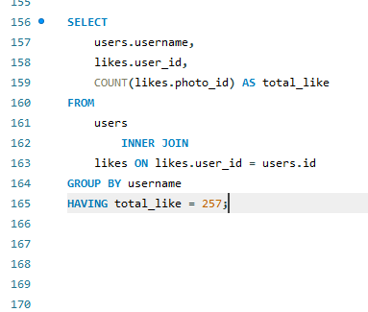
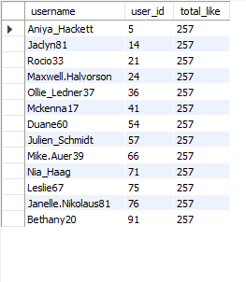
Bots & Fake Accounts:
Q. Identify users (potential bots) who have liked every single photo on the site, as this is not typically possible for a normal user.
Understanding: After joining the user's table with the likes table, we have the name of the user who likes each photo. Now, we have grouped the data using the username and filter likes with a total number of posts which is 257 as per the last query.
Now we know that there are 13 accounts that liked every posted photo on Instagram.

Slide 12
Result
• After sorting the data, we got the 5 oldest accounts or loyal users of Instagram. Daryby_Herzog, Emilio_Bernier52,Elenor88, Nicole71, and Jordyn_Jacobson2. Now we can give them a reward for using the platform regularly.
•We have the details of all 26 accounts that are inactive and now we need to start sending marketing emails or some special offer emails to attract the users to use the platform again.
•As per the data, we know Zack_Kemmer93 is the winner of the contest with maximum likes on a single photo. So it’s time to share the reward with the winner.
•Smile, beach, party, fun, and concert are the trending and most used hashtags on Instagram.
•According to the output, we can launch the campaign either on Thursday or Sunday.
•We have 100 users on Instagram with 257 total photos. So the average post per user is 2.57 which is about 2-3 posts.
•Need immediate attention to further check these 13 accounts as these could be bots and can be dangerous for security.

Slide 13


